Slide 1

Multi-Modal Duplicate Product Detection on Shopee
KM6312 BUBBLE TEAM SHAN MINQIAN G2507390C
BAO CENCEN G2507353B
ZHANG JINGWEN G2507507D
QU YING G2506960G
SHEN YANBO G2503429B

Slide 2
01
02
03
INTRODUCTION
DATA PREPROCESSING
TEXT MODELING
TABLE OF CONTENTS
04
05
06
IMAGE MODELING
MULTI-MODEL FUSION
EXPECTED OUTPUTS & BUSINESS VALUE
07
CONCLUSION

Slide 3

01
Introduction

Slide 4
Background
Shopee’s open marketplace allows multiple sellers to list the same product.
This creates duplicate and near-duplicate listings with different titles, images, and seller info.
Key Problems
Cluttered search results filled with repeated items.
Fragmented reviews/ratings, weakening social proof and trust.
Higher user effort to identify truly distinct products.
Lower search & recommendation efficiency, hurting CTR and conversions.

Slide 5
Project Goal
Build a multi-modal duplicate detection model using:
Product titles, images, and structured attributes (price, brand, category).
Automatically identify and group duplicate listings into unified product clusters.
Business Value
Cleaner search experience with fewer repeated items.
Consolidated reviews → stronger trust and higher conversions.
Fairer exposure for sellers by reducing duplicate spam.
Supports platform growth through improved user experience and navigation.

Slide 6
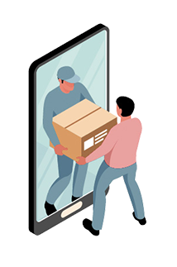
02 Data Preprocessing

Slide 7
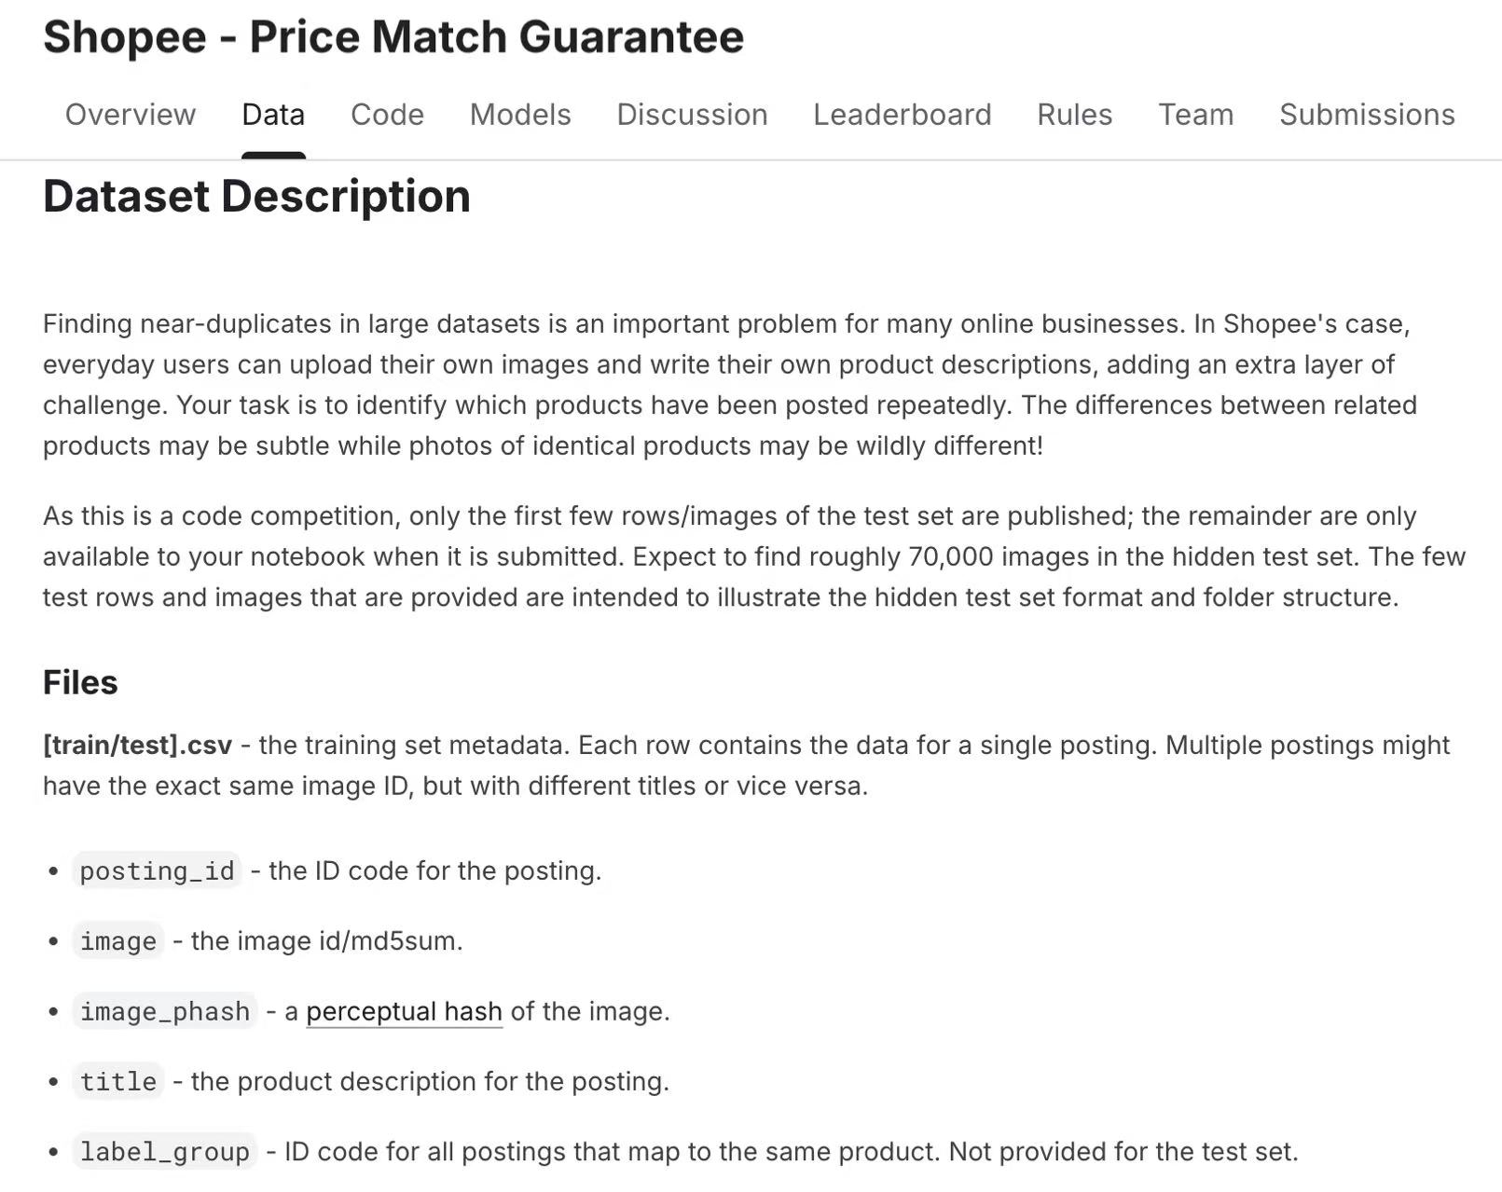
Dataset
Official Shopee Product Matching (Kaggle)
Product listings for duplicate-detection in e-commerce
Used to train and evaluate multi-modal similarity models
Key Fields
posting_id — unique listing ID
image — product image file
title — seller-provided title
label_group — ground-truth duplicate group ID

Slide 8
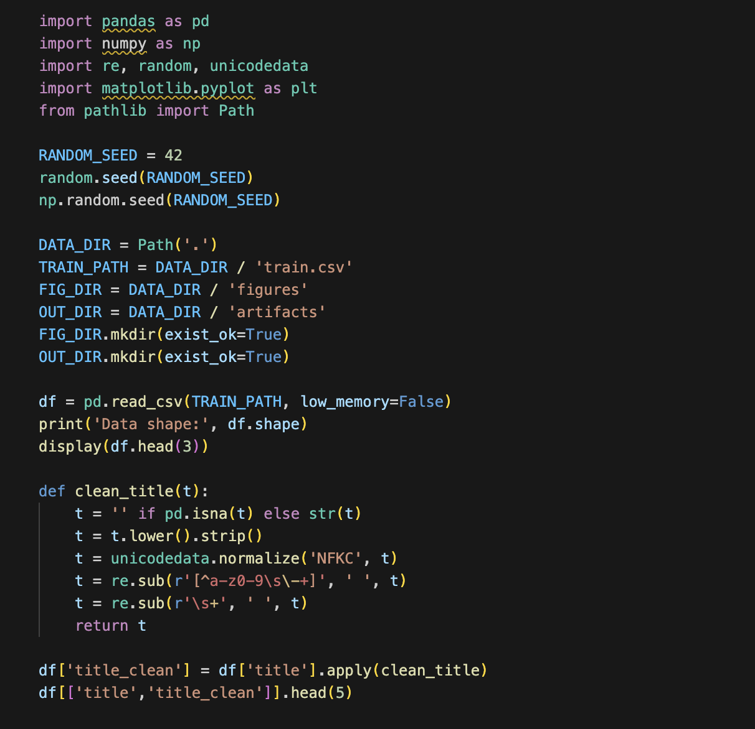
Text Cleaning (title_cleaned)
Convert to lowercase
Remove punctuation, emojis, HTML tags
Remove repeated spaces
Filter invalid or empty titles
Output: title_cleaned
Text Normalization (title_norm)
Stopword removal
Stemming / lemmatization
Normalize number–unit formats (e.g., 128 GB → 128gb)
Output: title_norm
Used for TF-IDF, cosine similarity, and text embedding models.

Slide 9
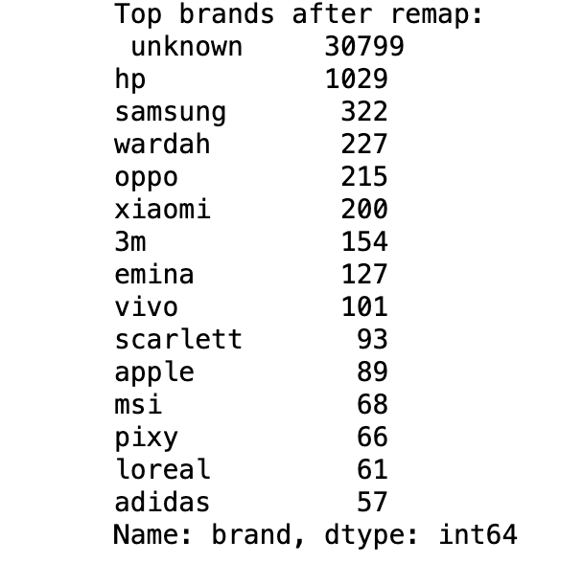
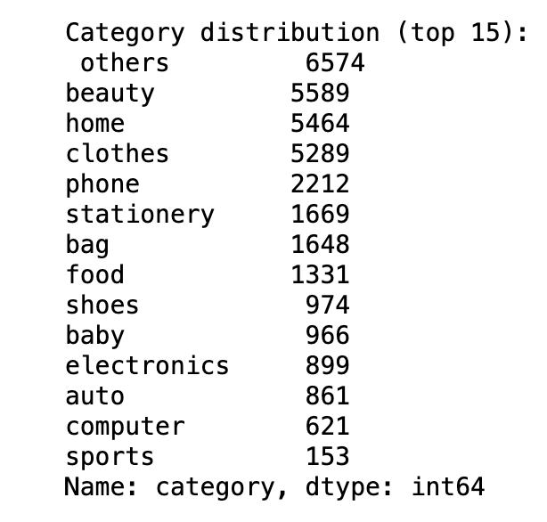
Structured Feature Construction
Brand Extraction
Rule-based matching using a predefined brand dictionary
Examples: vivo, Xiaomi, Samsung, adidas
Unrecognized brands → unknown
Category Extraction
Keyword-based mapping to categories such as
beauty
home
clothes
phone
stationery
Low-frequency categories merged into Others
New fields created: brand, category
Limitation: Shopee titles mix languages and contain many niche brands → rule-based extraction has natural constraints.

Slide 10
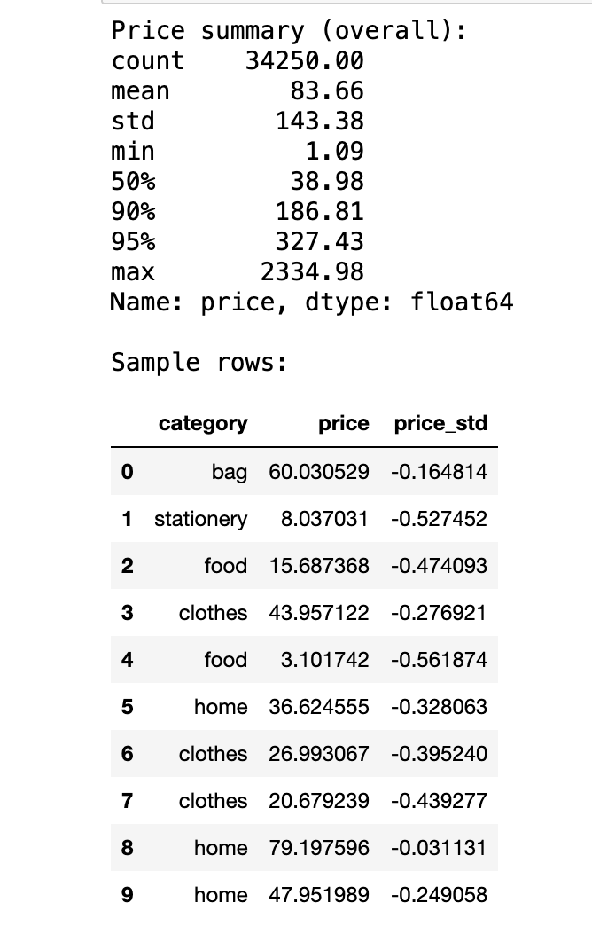
Price Construction & Standardization
Shopee’s raw dataset does not provide price, so we constructed it.
Simulated Price (price)
Generated within reasonable e-commerce price ranges
Adjusted loosely based on product type
Standardized Price (price_std)
Z-score standardization
Ensures consistent scaling for modeling
📌 New fields: price, price_std

Slide 11
Exploratory Data Analysis (EDA)
To better understand the structure and distribution of the processed dataset, we conducted three key visual analyses:
Category distribution
Price distribution (log scale)
Label group size distribution
These analyses help identify imbalance, noise patterns, and structural characteristics of the dataset.

Slide 12
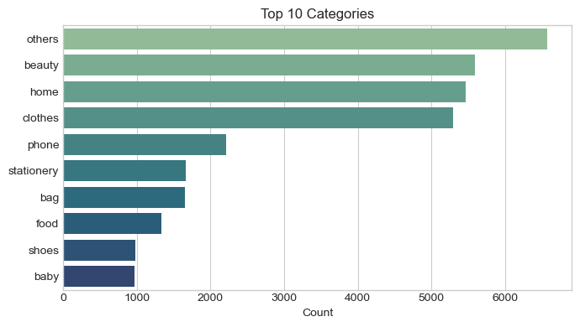
Exploratory Data Analysis (EDA)
Top 10 Product Categories
Interpretation:
Others is the largest category due to rule-based extraction limitations & mixed-language titles.
Major identifiable categories include beauty, home, clothes, phone, each with over 2,000–5,000 samples.
Long-tail categories such as shoes and baby appear less frequently.
Indicates： imbalanced category distribution, which is common in e-commerce datasets.

Slide 13
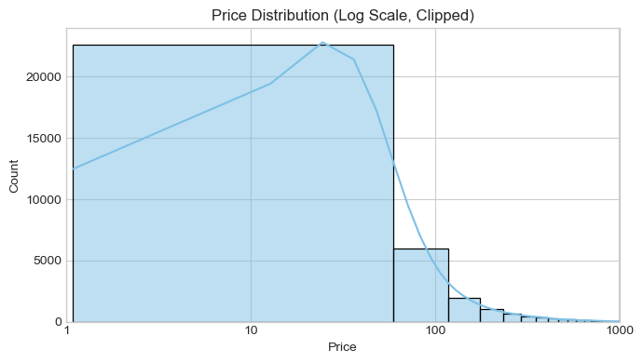
Exploratory Data Analysis (EDA)
Price Distribution (Log Scale)
Interpretation:
Simulated prices follow a realistic right-skewed pattern similar to marketplace price distributions.
Most items fall in the low-to-mid price range (1–100 units).
A few higher prices exist but are rare, matching typical long-tail price behavior.
Using log scale reveals the distribution clearly and reduces skewness.

Slide 14
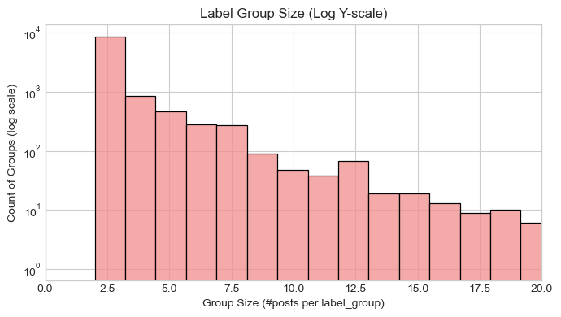
Exploratory Data Analysis (EDA)
Label Group Size (Duplicate Group Sizes)
Interpretation:
Majority of label groups contain 2–3 items, meaning most duplicates are small clusters.
A long-tail pattern exists, with a few groups containing 10–20+ items.
Log-scale y-axis highlights the strong imbalance and sparsity of duplicate clusters.
This distribution confirms that duplicate detection is highly imbalanced, requiring careful sampling strategies.

Slide 15
Image Preprocessing
To ensure that all product images are consistent and usable, we applied simple but essential preprocessing steps:
Converted all images to RGB format to unify color channels
Resized images to a fixed resolution (e.g., 224×224) for consistency
Removed unreadable or corrupted files to maintain data quality
Extracted basic visual features, including
width and height
average RGB values
grayscale brightness
These steps make the images clean, standardized, and ready for multi-modal analysis.

Slide 16
03
Text Modeling

Slide 17
Text-only Duplicate Detection
Objective:
Approach:
Detect duplicate products using only textual data (title_clean)
Build TF-IDF baseline
Apply Sentence-BERT for semantic matching
Evaluate both using precision, recall, F1-score, accuracy

Slide 18
Model Selection & Parameter Settings
TF-IDF Baseline
Vectorizer: TfidfVectorizer(max_features=5000)
Similarity: Cosine similarity
Sentence-BERT
Model: paraphrase-multilingual-MiniLM-L12-v2
Embedding batch size: 64
Similarity: Cosine similarity via util.cos_sim()

Slide 19
STEP 3
STEP 1
STEP 2
STEP 4
Modeling Pipeline
Generate candidate pairs
Predict duplicates using threshold = 0.7
Compute similarity scores (TF-IDF or SBERT)
Evaluate against label_group

Slide 20
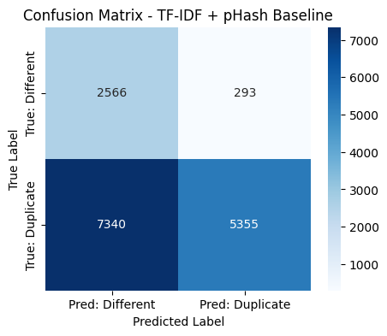
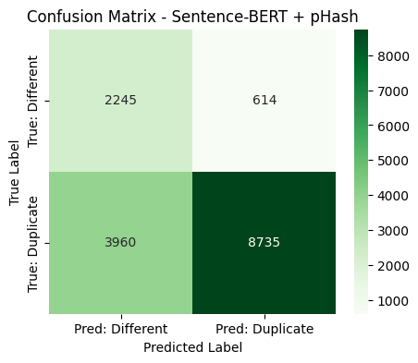
Performance Comparison
Accuracy: 0.5775 Precision: 0.9481
Recall: 0.4218 F1-Score: 0.5839
Accuracy: 0.7322 Precision: 0.9343
Recall: 0.6881 F1-Score: 0.7925

Slide 21
04
Image Modeling

Slide 22
EfficientNet B0
EfficientNet, a landmark architecture in automated deep learning, was conceived and developed by the Google Brain team (Tan, 2020). The architecture introduces a composite scaling method that can systematically extend the benchmark model. The extension method of EfficientNet has been verified in eight models (B0-B7). The method takes the compact B0 as the benchmark model, and then adopts composite expansion technology to gradually build a larger-scale and stronger model sequence from B1 to B7. In mobile or edge device application scenarios with limited computing resources, EfficientNet-B0 stands out for its excellent balance of efficiency and performance. Although larger-scale variants (B1-B7) have more parameters, B0 can show strong accuracy in tasks such as image classification and target detection, making it an ideal choice for calculating budgets (Kansal, 2024).
This study uses a pre-trained EfficientNetB0 model to extract high-level visual embeddings. The Shopee product dataset contains more than 34,000 product images. EfficientNetB0 provides a strong accuracy–efficiency trade-off and can extract embeddings for 30K+ images within reasonable runtime on a laptop environment.

Slide 23
Perceptual hashing (pHash)
Perceptual hashing is an advanced hash technology, which is originally designed to make the human perception system think that similar media content can produce the same or similar hash values.
Perceptual hashing’s processing process include (Zauner, 2010):
Convert the image to grayscale first.
Blurring and gamma correction
Extract features and build hashes
This project uses pHash to generate a 64-bit perceptual signature for each image, which can be used for coarse similarity filtering and eliminating obviously different pairs.

Slide 24
Image-only Experiment EfficientNet B0
Image Preprocessing:
Resize to 224×224 — required by CNN backbones
Normalize pixel values to [0,1]
Convert BGR → RGB (OpenCV default → TensorFlow format)
Handle corrupted and missing images
Embedding Extraction:
Use EfficientNet-B0 without classification head
Global Average Pooling → Each image → 1280-dimensional embedding vector
Output Example
Shape: (34,250 images × 1280 features)

Slide 25
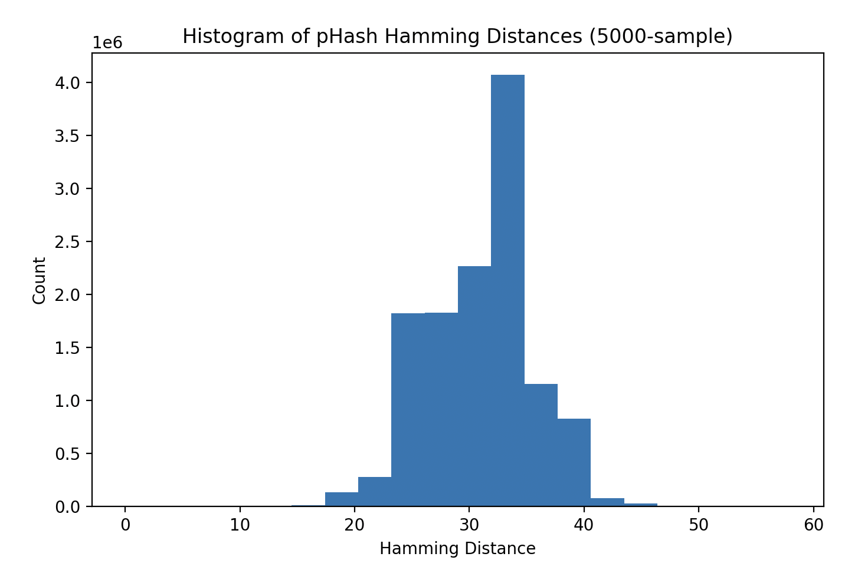
Image-only Experiment pHash
The histogram shows an obvious multi-peak structure:
The vast majority of unrelated product pairs are in the range of 22-40.
Small clusters of medium-similarity goods are concentrated in the range of 10–18.
Only a few pairing distances are less than 10, which strongly suggests similar duplicate or highly similar goods.
Based on this empirical distribution, we evaluate the candidate threshold from the conceptual level:
Although the threshold below 10 can achieve extremely high accuracy, it will omit a large number of legal similar goods (low recall rate).
A threshold higher than 18 will significantly expand the candidate pool, increase the calculation overhead and introduce excessive false alarms.
Therefore, selecting the threshold of Hanming distance ≤15 can achieve practical balance - not only retaining most visual similarity terms, but also effectively filtering irrelevant terms.

Slide 26
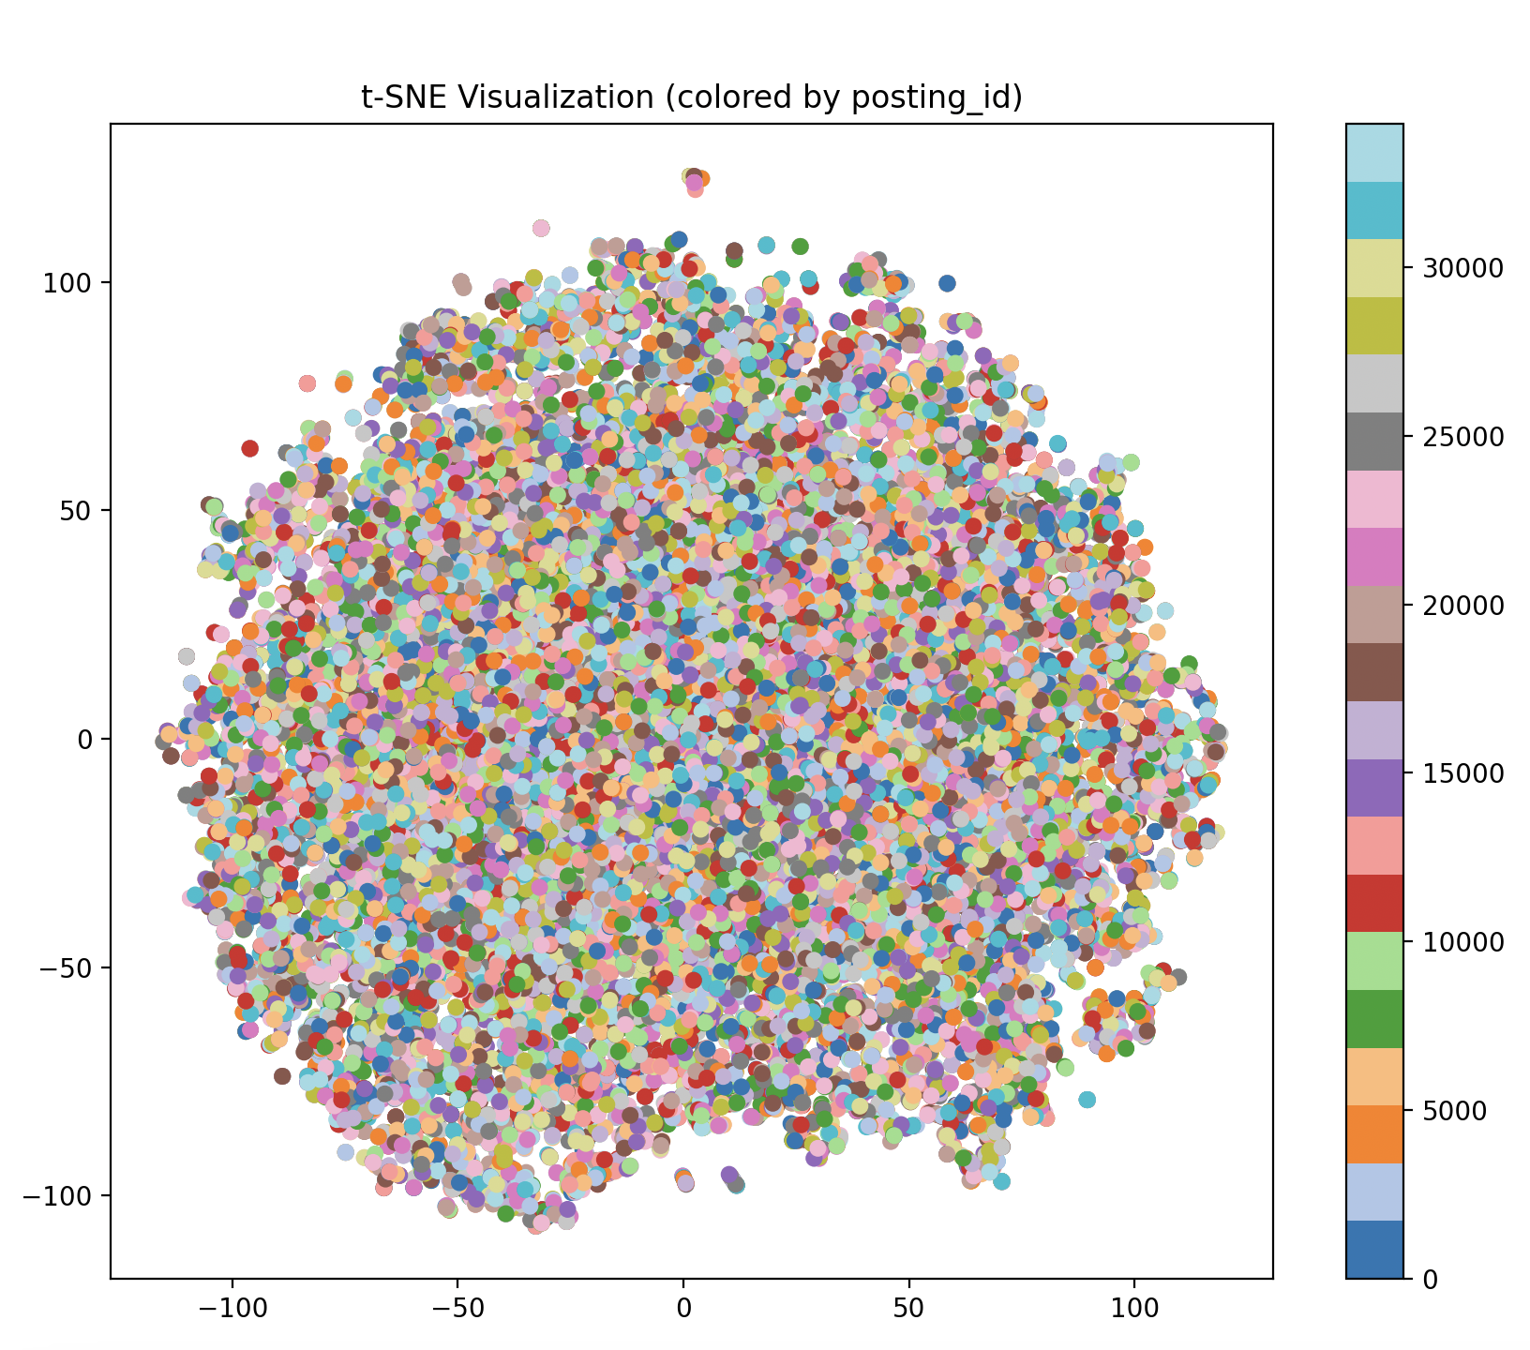
Key Findings from Image-only
To present the structure of the 1280-dimensional embedding space more intuitively, we employed t-SNE to reduce it to a two-dimensional plane. Each point corresponds to a product image and is colored according to its posting_id. Since posting_id can uniquely identify each image, the color presents a random mixed state, which is in line with expectations.
Although global clusters cannot be observed when coloring according to posting_id, local neighborhoods can still capture visual similarity, this meets the requirements of repeated commodity detection.

Slide 27
05
Multi-Modal Fusion

Slide 28
Multi-Modal Fusion
Technical Architecture Overview
Raw Data
Preprocessing
Feature Fusion
Leakage-Safe Split
Pair Generation
Model Training
Evaluation
Scikit-learn
SBERT
Light GBM
Efficient- Net

Slide 29
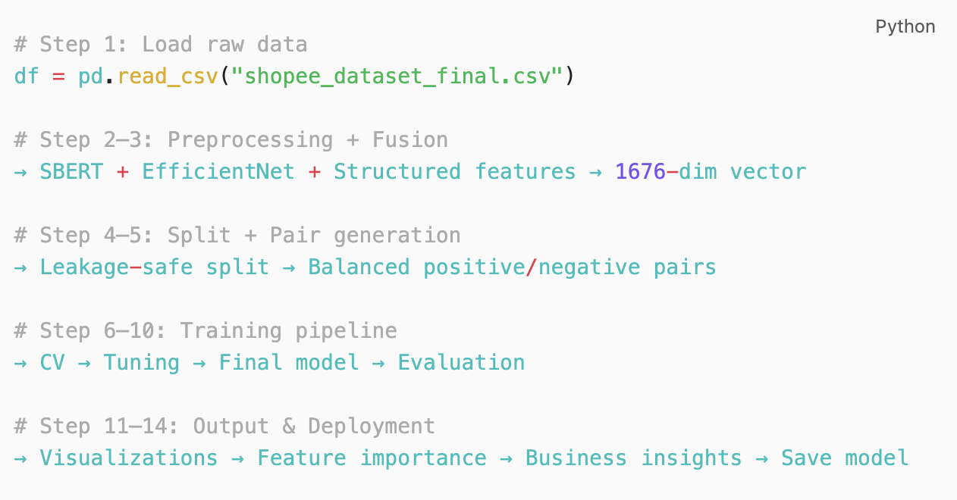
Multi-Modal Fusion
Technical Architecture Overview
End‑to‑end pipeline: raw CSV → deployable model
Modular design: preprocessing, fusion, training, evaluation
Leakage‑safe split by posting_id
Core stack: Scikit‑learn, LightGBM, SBERT, EfficientNet
Automated and reproducible workflow

Slide 30
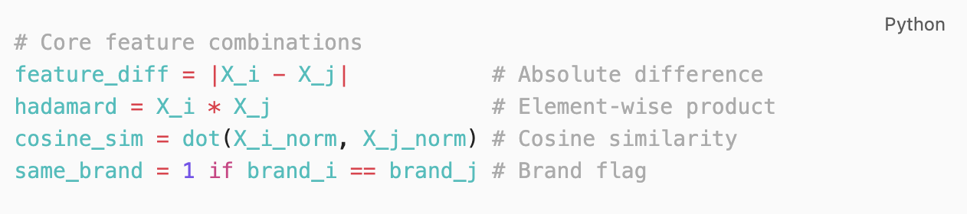
Multi-Modal Fusion
Feature Engineering
Feature Modalities
Modality | Dimension | Implementation
Text | 384 | Sentence‑BERT embeddings
Image | 1280 | EfficientNet embeddings
Structured | 12 | Price, brand, category, image statistics
Unified feature vector: 1676 dimensions
Pairwise Feature Construction

Slide 31
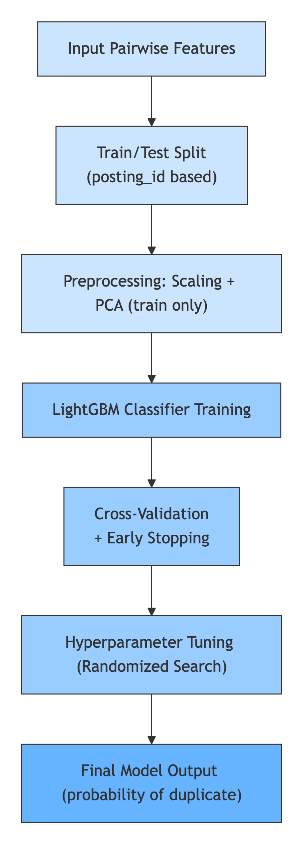
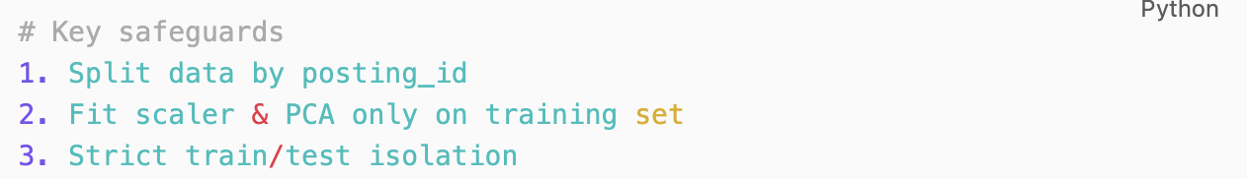
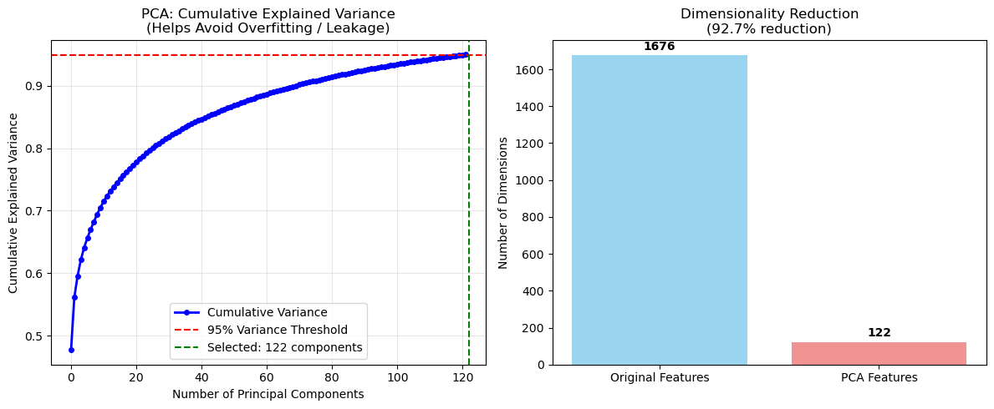
Multi-Modal Fusion
LightGBM
Training Workflow
Model Design & Training
Leakage Prevention
PCA fitted only on training set
PCA Cumulative Explained Variance Curve
Dimensionality reduction: 1676 → 122 components (95% variance)

Slide 32
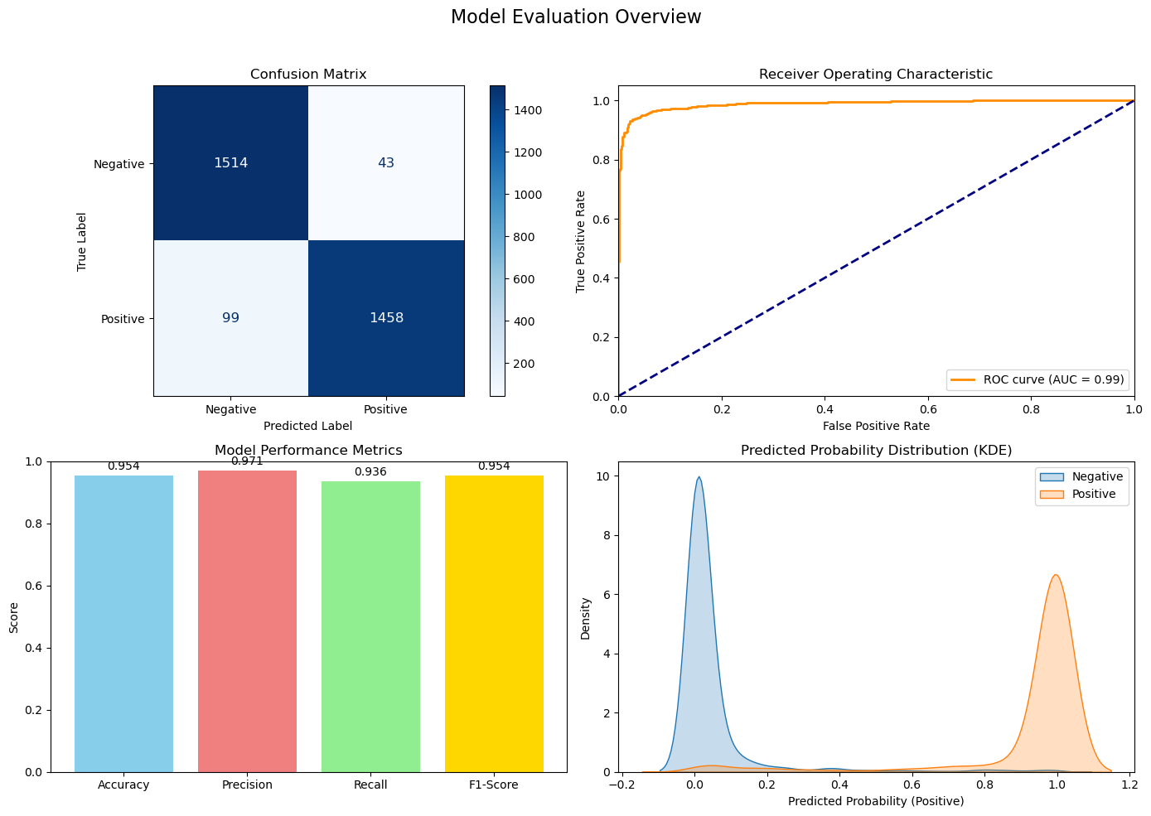
Multi-Modal Fusion
Performance Analysis
Confusion matrix shows low FP/FN
AUC: 0.9883
ROC curve indicates strong separability
Accuracy: 95.44%
Precision: 97.14%
Recall: 93.64%
F1‑Score: 95.36%
KDE probability distribution shows clear separation between duplicates and non‑duplicates.

Slide 33
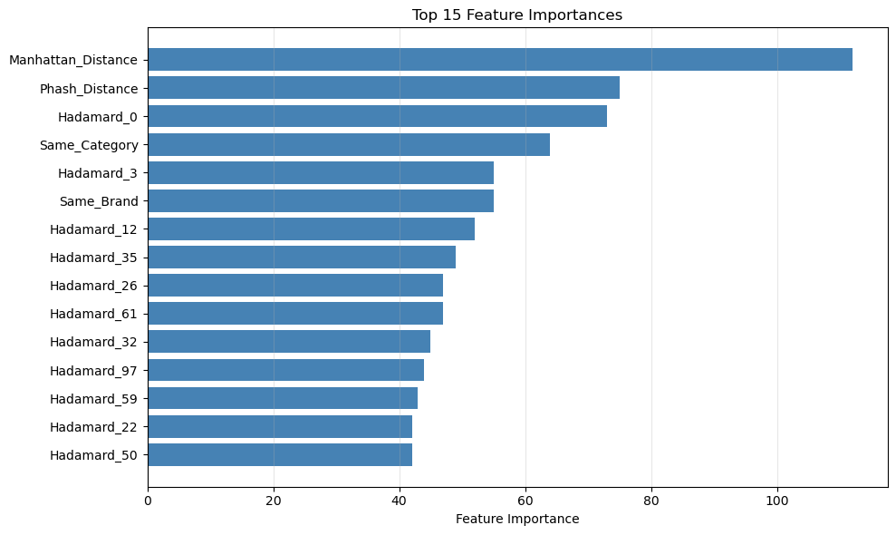
Multi-Modal Fusion
Ablation Study & Insights
Feature Importance Analysis
Manhattan distance (text embeddings): strongest semantic signal for pairwise similarity
pHash similarity (image): captures visual resemblance, useful for hard negatives
Hadamard product (text): encodes interaction between embeddings
Category/Brand match flags: provide strong structural cues for duplicates
Text + Numeric features yield best performance (F1 = 0.9873)
Text only performs nearly as well (F1 = 0.9866)
Text features dominate the overall signal
Selective fusion is necessary
Feature Set | F1 | AUC | Rank
Text + Numeric | 0.9673 | 0.9917 | 🥇
Text Only | 0.9656 | 0.9924 | 🥈
Text + Image | 0.9565 | 0.9883 | 🥉
All Features | 0.9560 | 0.9885 | 4
Image + Numeric | 0.8798 | 0.9396 | 5
Image Only | 0.8792 | 0.9381 | 6
Numeric Only | 0.8718 | 0.9341 | 7

Slide 34
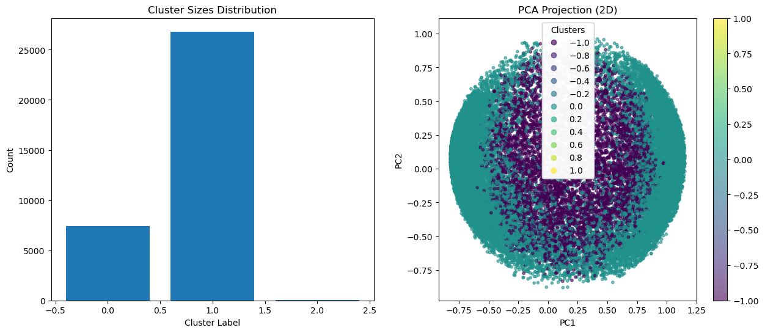
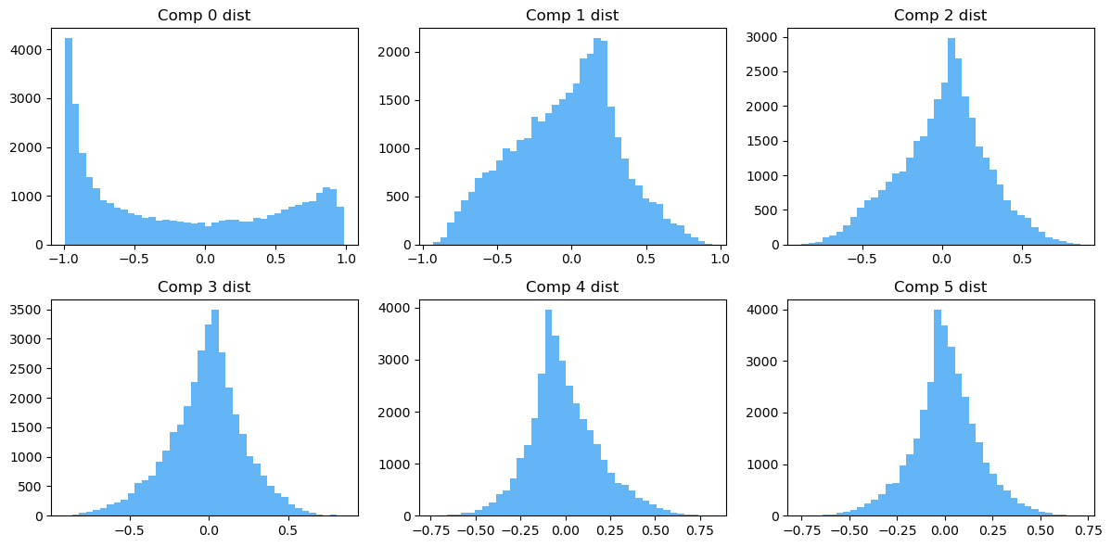
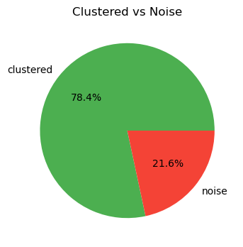
Preliminary Clustering Attempt
DBSCAN on PCA‑reduced features (122 components)
Suggested eps: 0.20 (cosine distance)
Two major clusters identified
PCA projection shows clear separation
Clustered vs Noise: 78.4% vs 21.6%
Component distributions mostly Gaussian‑like
Potential for unsupervised grouping

Slide 35
06 Expected Outcomes & Business Value

Slide 36
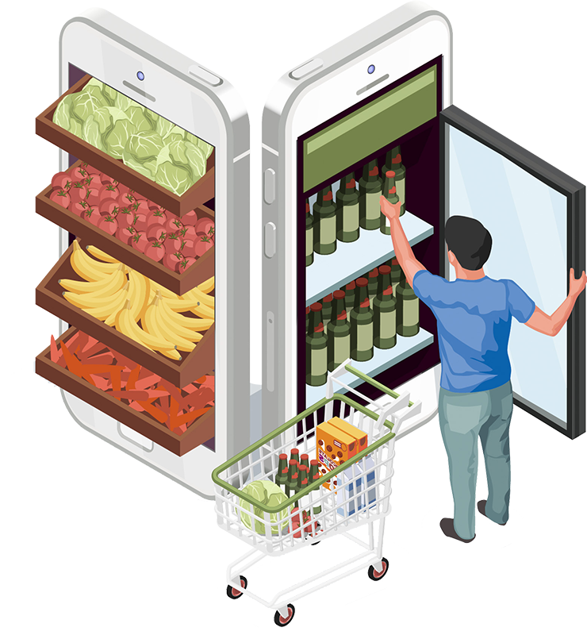
Commercial Problem & Motivation
Shopee marketplace suffers from duplicate and near-duplicate product listings
Consequences: search clutter, fragmented reviews, weak credibility, lower conversion
Duplicate listings reduce user trust and increase bounce rate
Key metrics affected: CTR ↓, CVR ↓, GMV ↓
Business need: automated, scalable duplicate detection → quality, fairness, revenue

Slide 37
Expected Outcomes – Platform-Level Impact
AREA
OUTCOME
Search Quality
User Behavior
Engagement Metrics
Purchase Confidence
Revenue Impact
Cleaner interface, higher content relevance
Faster search navigation, higher trust
CTR ↑ due to more meaningful clicks
CVR ↑ through unified ratings & reviews
GMV ↑ due to CTR × CVR uplift

Slide 38
How Duplicate Detection Drives Business Metrics
Cleaner Catalog → Better Guidance → Higher Trust → More Purchases
Business Metric | Impact
CTR ↑ | Reduced noise → More relevant clicks
CVR ↑ | Centralized reviews → Stronger purchase decision
GMV ↑ | Higher CTR and CVR lead directly to revenue growth
Bounce Rate ↓ | Less frustration → Higher retention

Slide 39
Marketplace Ecosystem & Governance Impact
Prevents sellers from posting duplicate listings to manipulate exposure
Ensures fair visibility for authentic and small sellers
Strengthens platform governance and policy enforcement
Reduces customer disputes and misleading product claims
Builds a trusted and sustainable marketplace ecosystem

Slide 40
Operational and Strategic Benefits
Area | Benefit
Moderation Cost | Automated duplicate detection reduces manual review burden
Efficiency | Approves quality listings faster, filters fake/repeated uploads
Content Quality | Standardizes catalog, improves metadata consistency
Scalability | Suitable for real-time deployment at platform level

Slide 41
Business Value Chain
Multimodal Duplicate Detection
↓
Cleaner Search Interface & Unified Product Pages
↓
CTR ↑ CVR ↑ Trust ↑
↓
GMV ↑ Seller Fairness ↑ Moderation Cost ↓
↓
Platform Governance & Long-Term Sustainability
Shows how technical model links to business metrics & ecosystem health
Demonstrates cascading value from search quality to marketplace trust
Highlights both revenue and governance dimensions

Slide 42
07 Conclusion

Slide 43
Final Takeaway: What This Project Proves
Multimodal fusion (Text + Image + Metadata) outperforms single-source detection
pHash improves candidate retrieval speed and complements deep models
Duplicate detection is not only a technical challenge, but a commercial enabler
Direct impact on: search quality, CTR, CVR, GMV, fairness, and governance
Supports real-world deployment in Shopee-like e-commerce environments

Slide 44
Future Deployment Potential
Real-time duplicate detection at upload
Integration into platform policy & fraud detection systems
Multilingual brand ontology expansion
Business KPI dashboard (CTR, CVR, GMV tracking)
Unified Product Page (UPP) for review consolidation

Slide 45

THANKS

